Slide 1
PRODUCT RECOMMENDATION SYSYTEM AND ECOMMERCE
Mentor -- ANJANEYULU SIR
Team Members -- J.FRANKLIN
N.SHIVANI
G.MANISHA
D.SRI LAXMI
K. VAISHNAVI

Slide 2
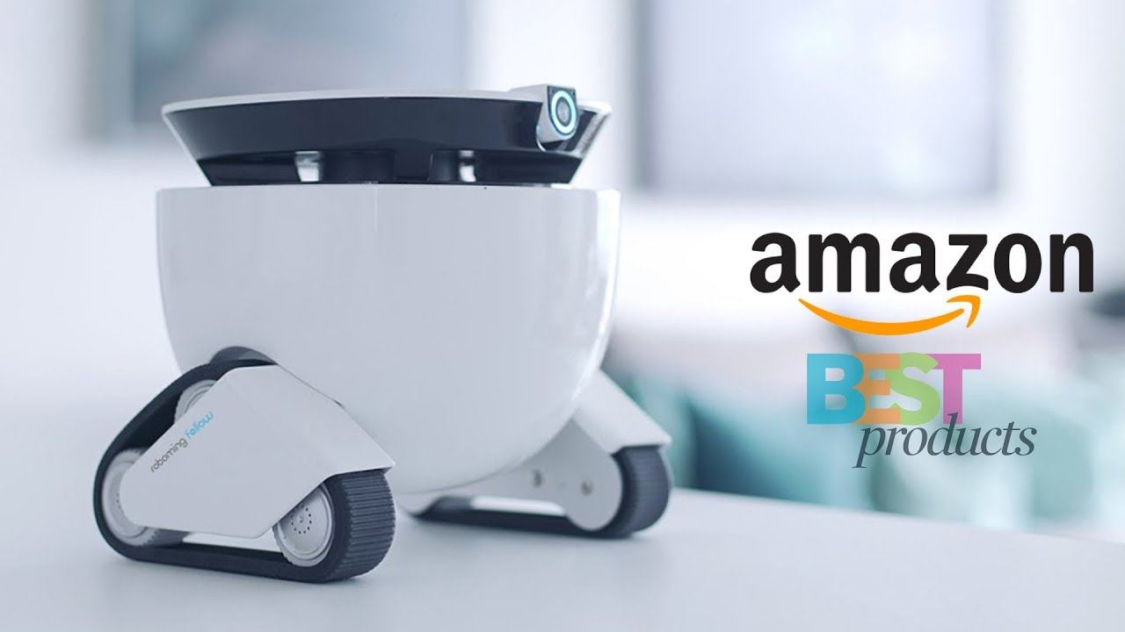
OBJECTIVE
TO RECOMMEND TOP 10 BEAUTY PRODUCTS ON AMAZON APP BASED ON CUSTOMER REVIEWS

Slide 3
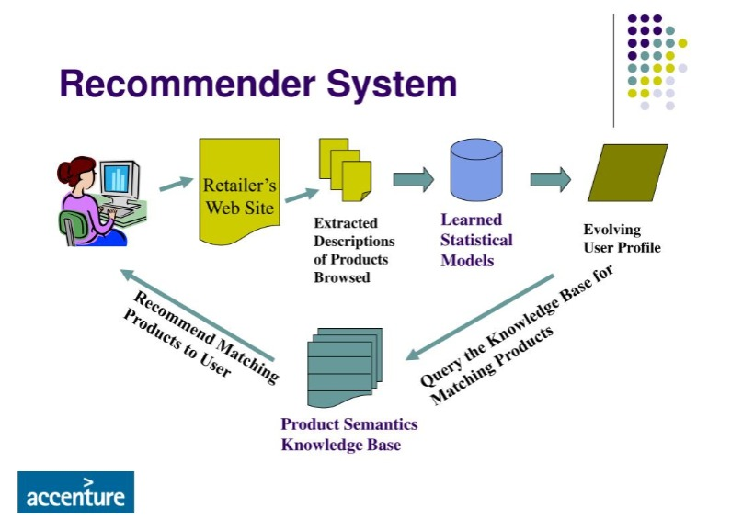
Abstract
This technical report examines the literature and explains the Recommender System ideas. A recommendation engine is a system that filters information to bring movies , music, books etc to the user. A set of tools to a user , this data has been vetted to ensure that it is likely to pique the user’s interest .

Slide 4
Introduction to Recommender Systems and E-Commerce

Slide 5
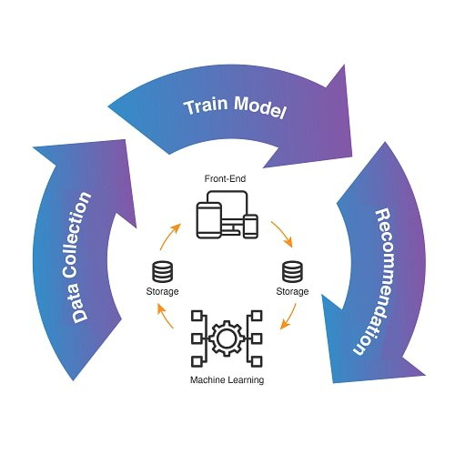
RECOMMENDER SYSTEMS
Recommendation system is a technology which is used for filter and retrieval the data .
In the methods of unsupervised machine learning ,the task of machine or model is to group the uncategorized data , according to similarities, patterns and differences without given any kind of training to the machine
These can be based on various criteria ,including past puchases ,search history, demographic information , and other factors

Slide 6
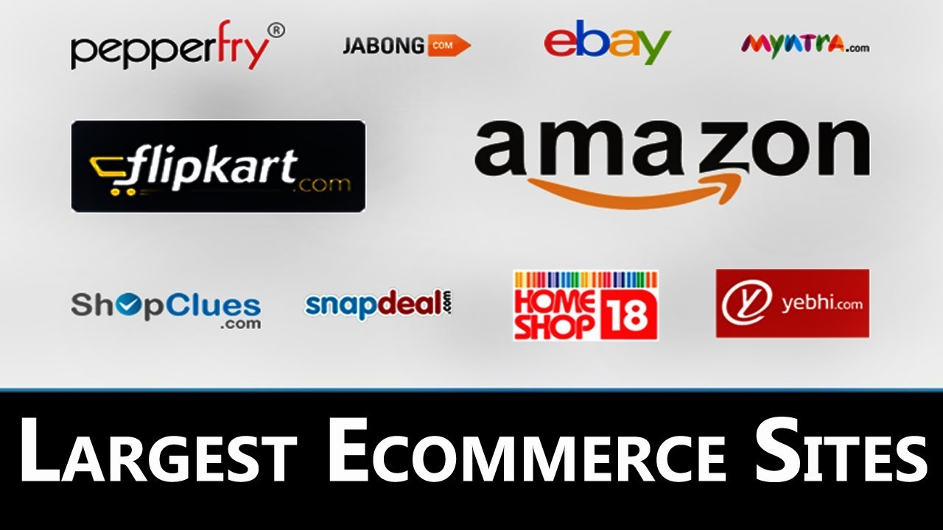
E-COMMERCE
“E-commerce" or "electronic commerce" is the trading of goods and services on the internet. It is your bustling city center or brick-and-mortar shop translated into zeroes and ones on the internet superhighway.
Ecommerce works by connecting buyers and sellers using various electronic channels.
For example, you need a channel, such as a website or social media, so customers can find products and services to purchase. Then a payment processor enables the exchange of the goods or services. Once the transaction succeeds, the customer receives a confirmation email or SMS, and a printable receipt.

Slide 7
Literature Review
The significant chanllanges of collaborative filtering -- sparsity
-- scalability
Collaborative filtering measures -- cosine metric
-- jaccard coefficient
-- personalized data
Due to data sparsity , sales volumes on large e-commerce are decreasing.
Suggested that the developers of RSs should stop using the nearest neighbouring
SIVAPALAN

Slide 8
In UBCF techniques ,the recommendations are generated acc to the like or dislike of the neighbours node
G . GUPTA & R . KATARYA
In IBCF technique, the similarity between the items are calculated
The drawback of UBCF ---- if user U like an item I but his/her neighbours not gave good ratings good ratings to that item I will not be recommended
IBCF calculates similarity between two items
ZHAO , ZHI-DAN
&
MING

Slide 9
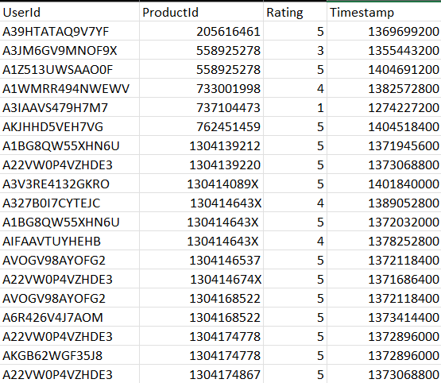
Source of the data
Collected the data of amazon beauty products from Kaggle website
https://www.kaggle.com/skillsmuggler/amazon-ratings
SAMPLE DATA
This is the sample data of size 20

Slide 10
Data Description
This dataset contains product reviews and metadata from Amazon, including 142.8 million reviews spanning May 1996 - July 2014.
It contains
the unique UserId (Customer Identification),
the product ASIN (Amazon's unique product identification code for each product),
Ratings (ranging from 1-5 based on customer satisfaction) and
of the rating (in UNIX time) the Timestamp

Slide 11
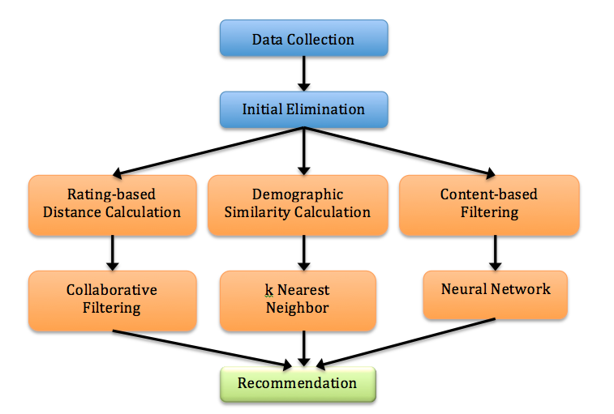
Methodology
Model based collaborative system
POPULARITY BASED REOMMENDATION SYSTEM
Popularity based are a great strategy to target the new customers with the most popular products sold on a business's website and is very useful to cold start a recommendation engine.

Slide 12
STATISTICAL TECHNIQUES
Collaborative Filtering
Measures or techniques used are -
- neighbour(cosine, correlation)
- clustering
- Graph theory
Commonly used techniques -
- Bayesian approach
- clustering
- Artificial nueral networks
- Linear regression
- Probabilistic models
CONTENT BASED RECOMMENDATION SYSTEM
Comparing user interests to product features . The products that have the most overlapping features with user interests are what’s recommended
HYBRID RECOMMENDATION SYSTEM
Uses both collaborative data and content based . Simultaneously which helps to suggest a similar or close item to the users
Methods we used are content based & collaborative filtering and techniques we used is correlation matrix based on data

Slide 13
Data Visualization

Slide 14
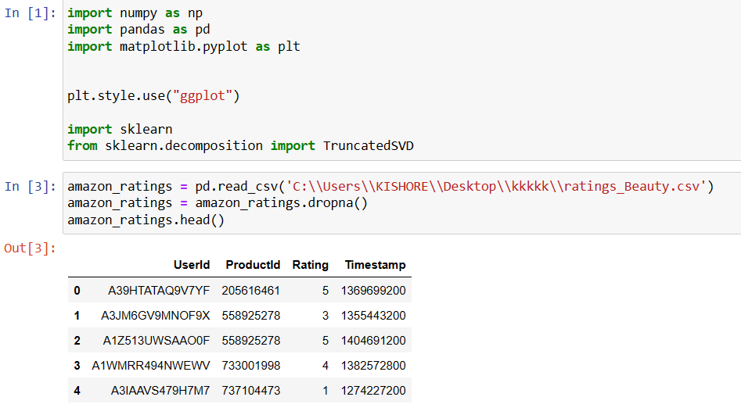
Popularity based Recommendation System

Slide 15
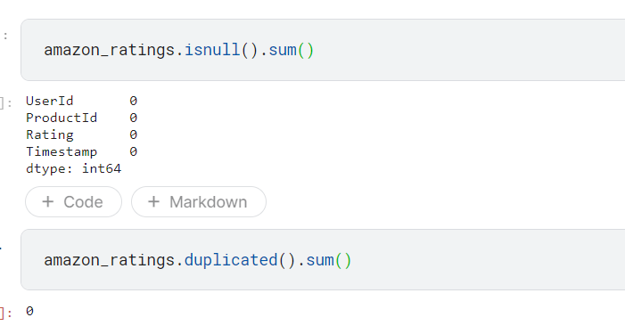

Slide 16
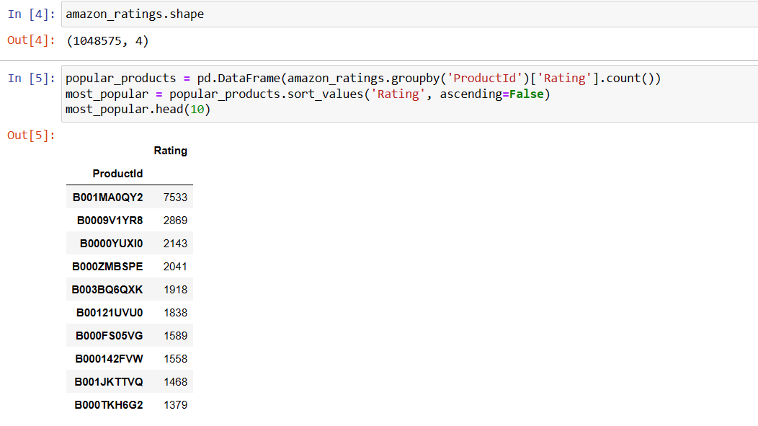

Slide 17
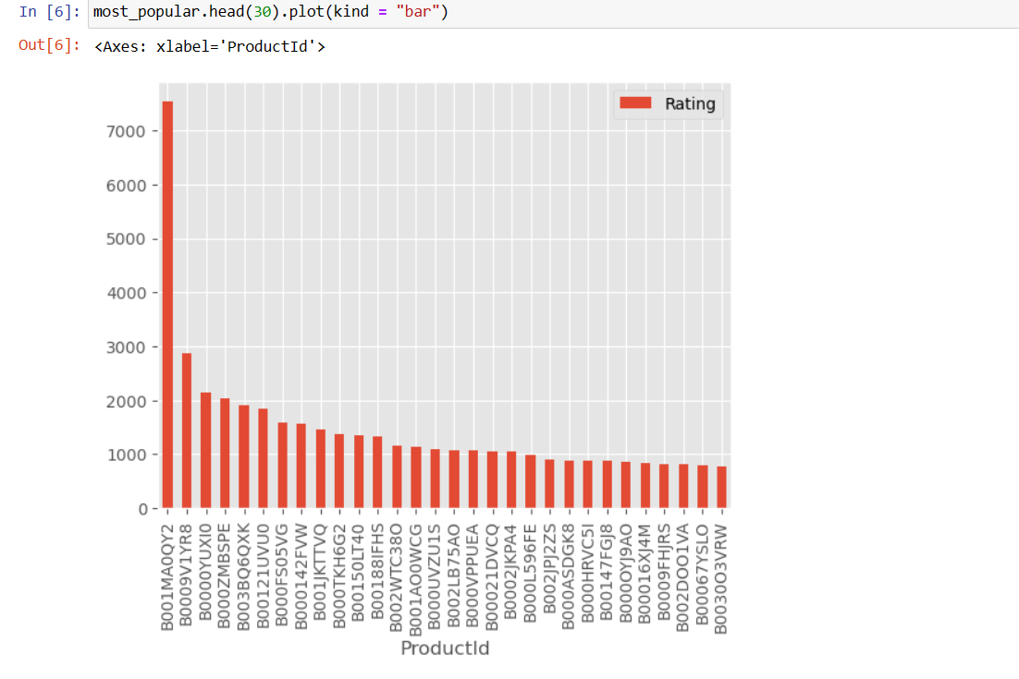
Analysis:
The above graph gives us the most popular products (arranged in descending order) sold by the business.
For eaxmple, product, ID # B001MA0QY2 ( Maybelline New York Sky High washable Masacara )has sales of over 7000, the next most popular product, ID # B0009V1YR8( PanOxyl Acne Foaming Wash ) has sales of 3000, etc.

Slide 18
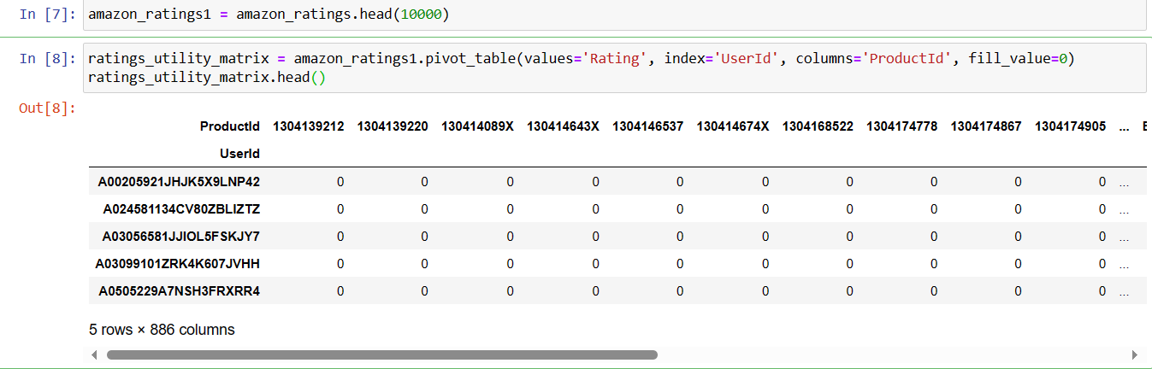
Item based collaborative using correlation matrix

Slide 19
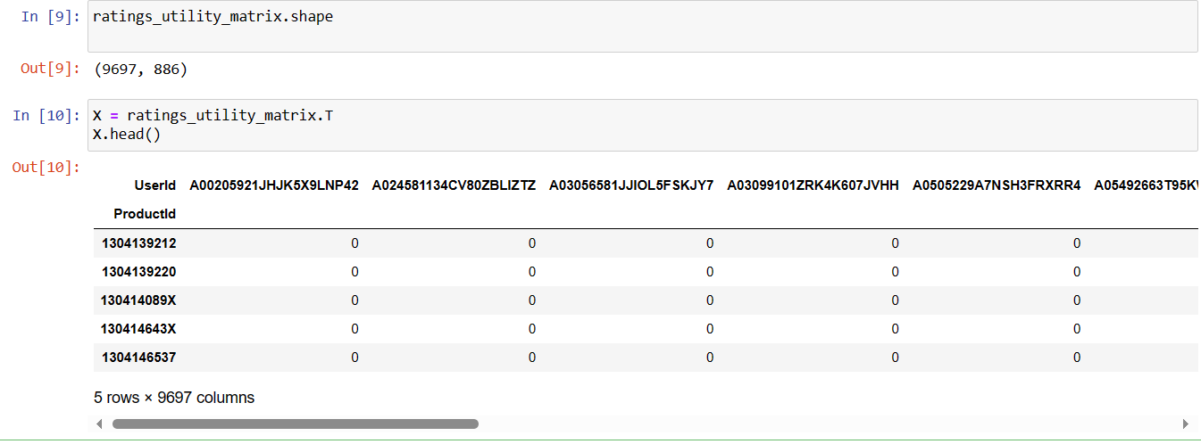

Slide 20
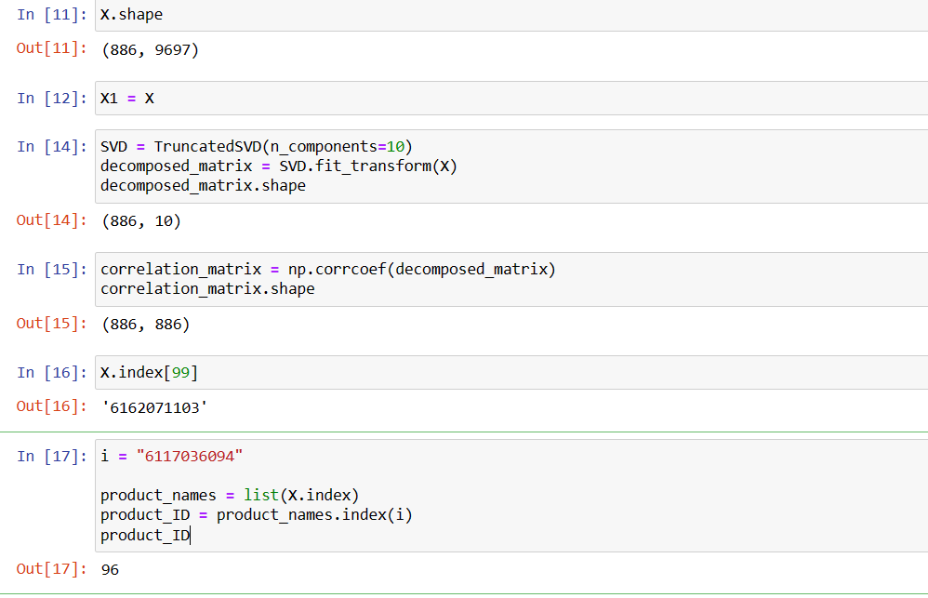

Slide 21
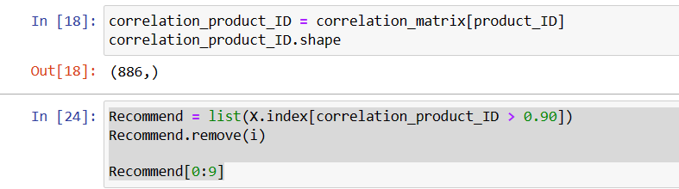
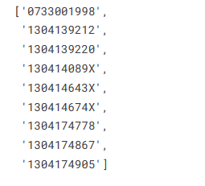
Conclusion:
Here are the top 10 products to be displayed by the recommendation system to the above customer based on the purchase history of other customers in the website. Products named -- L’Oreal Paris Voluminous Lash Paradise
-- Maybelline Instant Age Rewind
-- Differin GEL
-- Olaplex No.5 conditioner
-- Sol De Janeiro body fragrance
-- Laneige Lip Sleeping Mask
-- Revlon One-step Volumiser
-- Maybelline New York Matte ink liquid lipstick
-- Truskin Naturals vitamin C serum
-- Heeta scalp MAssager

Slide 22
Work Distribution
Franklin
- Objective
- Abstract
- Introduction to
recommendor system
Shivani
- e-commerce
- Literature
review
Manisha
- source of the
data
- Data
Description
Sri Laxmi
- statistical
Techniques
- Data Analysis using
Popularity based RSs
Vaishnavi
- Data Analysis using IBCF

Slide 23
REFERENCE
https://www.kaggle.com/code/shawamar/product-recommendation-system-for-e-commerce
https://www.google.com/url?sa=t&source=web&rct=j&opi=89978449&url=https://www.investopedia.com/terms/e/ecommerce.asp&ved=2ahUKEwif1enlyfeCAxXW1jgGHbmWDr4QFnoECEUQAQ&usg=AOvVaw3RYZWh2DHXhEBdLbNOdBlS
https://www.nvidia.com/en-us/glossary/recommendation-system/
https://www.techtarget.com/searchcio/definition/e-commerce
https://www.turing.com/kb/collaborative-filtering-in-recommender-system
https://www.miquido.com/blog/perks-of-recommendation-systems-in-business/

Slide 24
THANK YOU

